Slide 1
Dykman Electrical Presents:
AC Drive Principles 101

Slide 2
Variable Frequency Drive (VFD) Principles

Slide 3
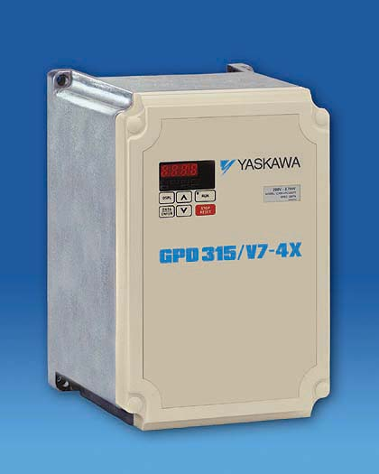
Variable Frequency Drive (VFD)
Device used to vary the speed of a driven load, such as pumps, blowers, compressors, conveyors & punch presses, to exactly match the process requirements & achieve energy savings too
Includes built-in overload protection (no heater elements required)
Adjusts both the frequency & voltage to the motor
Reduces the inrush current to 150% (adjustable) of the motor rated current
Notes:
Advantages: fully adjustable accel and decel times, fault diagnostics, reverse run without extra contactors, several monitor functions, saves energy
Disadvantages: higher initial cost than magnetic motor starter & reduced voltage motor starter

Slide 4
VFD Interconnection Diagram
B1
B2
Power Supply
L1
L2
L3
T1
T2
T3
IM
Forward Run
Multi-function Analog Output
1
2
3
4
5
6
7
8
11
0±10V 21
Reverse Run
Common 22
0±10V 23
Multi-function Analog Output
Multi-function Inputs
9
Multi-function Contact Output 250Vac/30Vdc, 1A
10
18
19
Fault Contact 250Vac/30Vdc, 1A
Digital Common
20
2K
15 (+15V, 20mA)
25
13 Main Ref.(0±10V)
Multi-function Open Collector Outputs 48v, 50mA
2K
14 Main Ref.(4-20mA)
26
16 Aux. Ref.(0±10V)
27
17 Analog Common
33 (-15V, 20mA)
Notes:
A typical VFD interconnection diagram as compared to the magnetic motor starter and reduced voltage motor starter.

Slide 5
VFD Sections
What are the different VFD sections?
A simple understanding of the VFD sections
What do you mean???

Slide 6
VFD Basic Configuration
Input
Output
Converter
Non-Regulated Rectifier
DC Voltage
Inverter
Voltage Controlled
AC Input Voltage
Variable Frequency
Variable Voltage
Constant V/f
Notes:
A VFD is made up of:
A converter section that consists of diodes that produce a fixed voltage DC bus
A DC bus that smoothes & stores the DC voltage
An inverter section that produces a variable voltage and variable frequency output.
A non-regulated rectifier is not controlled by the VFD, hence
the fixed DC voltage is at a level based on the AC input
voltage level

Slide 7
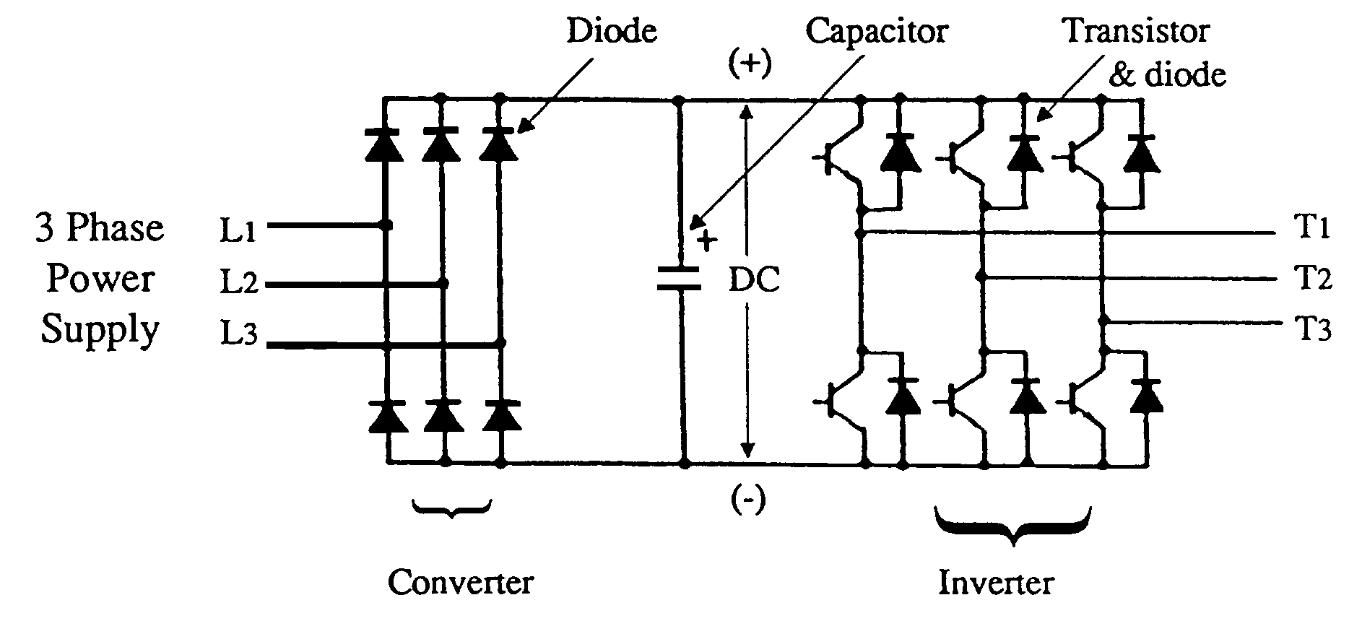
VFD Principle No.1
The inverter changes AC power to DC power and then changes it back to AC power
AC
DC
AC
Notes:
Lets take a closer look at the PWM inverter, and discuss some of basic principles.
The inverter changes the AC input power into DC power then changes it back to AC power.
The inverter is actual comprised of three sections;
1.) The converter section that changes the AC to DC
2.) The DC bus
3.) The inverter section that changes the DC back to AC
So when we call a variable frequency drive an inverter, this is technically incorrect

Slide 8
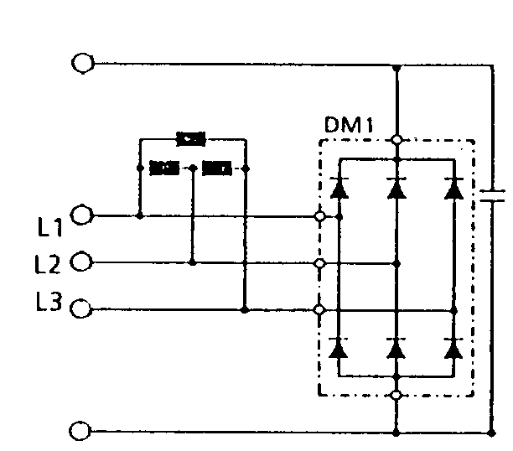
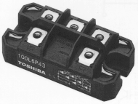
Converter Section
Cathode (-)
Anode (+)
Made up of diodes that convert input AC voltage to DC voltage
+
-
Schematic diagram
Notes:
Diode Definition: an electronic device that has two electrodes/terminals & is used especially as a rectifier. Only allows current flow in one direction and then only after the anode voltage is 0.7V greater than the cathode voltage.
The first component to talk about is the input diode. Some folks call this the input rectifier, same thing. The input diodes take the three phase AC power and convert it to DC power. DC power is the same thing that is in a flashlight battery. This DC power is just on a much larger scale. This is what a typical diode would look like. The electrical symbol shows a pair of diodes, which would used for one of the three phases. In the package shown here there are actually 3 groups of diodes.

Slide 9
DC Bus
Made up of capacitors used to smooth & store DC voltage
+
+
Notes:
Capacitor Definition: usually consists of conducting plates or foils separated by thin layers of dielectric (as air or mica) with the plates on opposite sides of the dielectric layers oppositely charged by a source of voltage and the electrical energy of the charged system stored in the polarized dielectric
After the three phase AC power is converted into DC power, it has a lot of ripple on it. To smooth this ripple, the inverter has what are called DC bus capacitors (we will talk about the DC bus in a minute). A capacitor is very similar to a battery, except it cannot hold a charge as long. The picture shown here, is a typical DC bus capacitor. Some people call the DC bus capacitors, smoothing capacitors.

Slide 10
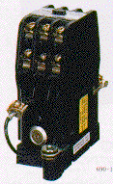
Soft Charge Resistor & Contactor
The soft charge resistor and contactor work together to “softly” charge the DC bus capacitors
Soft Charge Contactor
Output Transistors
Input Diode
Soft Charge Resistor
+
3 phase input
DC Bus Capacitors
Fuse
Notes:
Other commonly requested parts are the soft charge resistor and soft charge contactor. These two components work together to slowly charge the DC bus when power is applied to the inverter. This picture shows a typical soft charge resistor, and contactor. A resistor is nothing more than a coil of wire that resists the power flow in to the inverter. The contactor is just a heavy duty switch.
The other purpose of these components is that they limit the inrush current through the converter section.

Slide 11
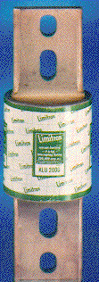
DC Bus Fuse
The DC bus fuse protects the rest of the inverter if the output transistors were to fail
Soft Charge Contactor
Soft Charge Resistor
Output Transistors
Input Diode
+
3 phase input
DC Bus Capacitors
Fuse
Notes:
Fuse definition: an electrical safety device consisting of or including a wire or strip of fusible metal that melts and interrupts the circuit when the current exceeds a particular amperage
Another common component in the main circuit is the DC bus fuse. The DC bus fuse ranges in size and shape. The fuse shown here is typical of the third generation type DC bus fuses.

Slide 12
The DC Bus
Connects the converter & inverter sections & supplies the desired DC voltage or DC current
Washington D.C....
Notes:
We have been mentioning the DC bus. Well the DC bus is not really a component in the inverter. If a customer calls and wants to purchase a spare DC bus, he is mistaken. The DC bus is an electrical point inside the inverter, that runs throughout the inverter. It connects what are called the main circuit components.

Slide 13
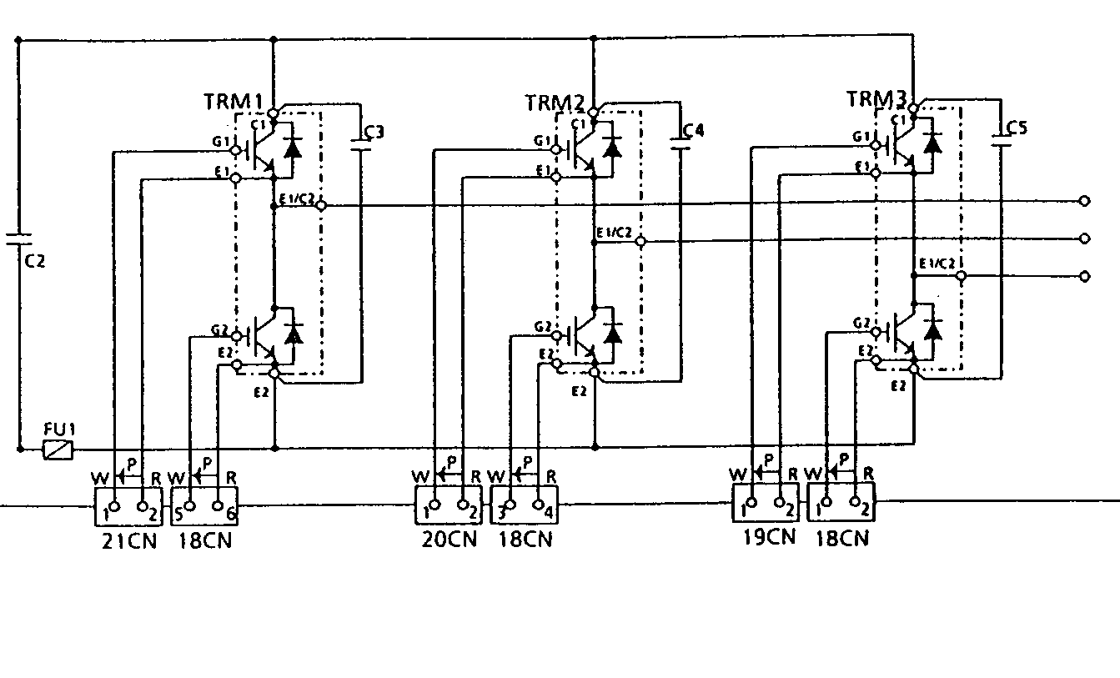
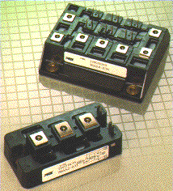
Inverter Section
Made up of transistors
Transistors are solid state “switches” that deliver the voltage and current to the motor
+
T1
T2
T3
-
2PCB Power Board
Notes:
The next major component in the main circuit are the output transistors. The output transistors are fancy switches that take the DC bus power and send it to the motor.
Clarification:
Voltage does not flow like current, but for our purposes, we will assign a direction to voltage.

Slide 14
Control Board
The control board accepts “real world” commands and controls the inverter to accomplish those commands
The “brain” of the VFD
“Speed up”
VFD Sections
“Speed up”
“Speed up”
Control Board
Notes:
Another very important part of the inverter is the control board. The control board is the brain of the inverter. You tell the control board to speed up, the control board tells the rest of the inverter to speed up.

Slide 15
Gate Drive Boards
“Speed up”
Main Circuit
Gate drive boards are circuit boards that hold the gate circuits and the power supplies
None of the main inverter section components are mounted to the gate drive board
“Speed up”
Gate Drive Board
Gate circuits
“Speed up”
“Speed up”
Control Board
Notes:
Larger units have gate drive boards. A gate drive board has the gate circuit and power supplies just like the power board, but does not have any of the main circuit components. Some people call this board the gate driver or on the older equipment
A “gate” is the control element of the inverter transistors. When a small positive voltage is applied to the gate momentarily, the IGBT will conduct current.

Slide 16
A Typical VFD Block Diagram
Soft Charge Contactor
Input Diode
Soft Charge Resistor
Output Transistors
Output to the motor
60.00
+
3 phase input
DC Bus Capacitors
DIGITAL OPERATOR
Fuse
A/D
D/A
ANALOG INPUT
ANALOG OUTPUT
Control Power
Voltage Feedback
GateDrive
Current Feedback
DIGITAL Input/Output
Gate Array
PROM
NV RAM
Micro
Processor
RAM
A/D
Notes:
Now that you know the main sections of a VFD, let’s take a look at a typical inverter block diagram. The inverter consists of three major components:
The main circuit
The Gate drive board
The control board.
The main circuit consists of all the high current carrying components that deliver power to the motor. It consists of (go over each part and give a simple explanation of each)
The gate drive board (also called the base drive board) is a go-between, from the control board to the main circuit. It consists of circuits (go over each circuit and give a simple explanation of each).
The control board is the inverters interface with the real world. It takes in commands (run, stop, slow down, speed up) and sends them to the gate drive board, which then sends them to the main circuit.

Slide 17
VFD Basic Configuration
Input
Fixed DC Voltage
Output
Converter
Non-Regulated Rectifier
Inverter
Voltage Controlled
AC Input Voltage
Variable Frequency
Variable Voltage
Constant V/f
460V
Volts
23V
0
1.5Hz
60Hz
Frequency

Slide 18
VFD Principle No. 2
Why keep a constant V/f ratio
460V
460V
= 7.67
“This ratio does not look constant to me”
60Hz
Volts
23V
= 15.3
23V
1.5Hz
0
1.5Hz
60Hz
Frequency
Notes:
So far we have talked about the V/f pattern of the inverter and that it is important to keep a constant volts per hertz ratio. If we do some investigation, we can see that the V/f ratio at 60Hz is about 7.67 and the ratio at 1.5Hz is about 15.3. This does not look constant to me! Lets look at this a little closer.

Slide 19
VFD Principle No. 2
Why keep a constant V/f ratio
11V
448V
= 7.34
= 7.46
1.5Hz
60Hz
A constant V/f ratio produces constant motor flux
A constant motor flux produces constant torque
This leads to the optimum amount of motor torque per amp
Notes:
And this leads to the optimum amount of motor torque per amp.

Slide 20
VFD Principle No. 2
Effects of improper V/f ratio
Low V/f ratio results in
Reduced motor flux which leads to reduced motor torque
Motor starving for voltage which leads to high current
High V/f ratio results in:
Over saturation condition that leads to high current but no more torque production
Motor overheating
Notes:
If the V/f pattern is set too high
An over saturation condition will occur that causes the motor to draw high current but not produce any more torque. This condition can cause the inverter to trip on overcurrent or overload faults. And obviously, with all the extra current the motor temperature is going to increase.

Slide 21
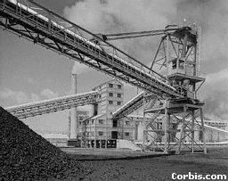
Loads and Load Characteristics
Constant Torque Loads
the torque requirement is the same regardless of speed
horsepower increases linearly with speed
Lifting Equipment, Conveyors, Rolling Mills, Extruders, and Planers are examples of constant torque loads.
Torque = Constant
Hp = Speed

Slide 22
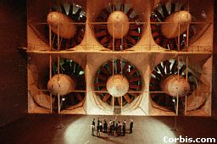
Loads and Load Characteristics
Variable Torque Loads
the torque requirement increases as the square of the speed
the horsepower requirement increases with the cube of the speed
Fans, Blowers, Centrifugal Pumps, and Centrifuges are examples of this type of equipment
Torque = Speed Squared (N²)
HP = Speed Cubed (N³)

Slide 23
Loads and Load Characteristics

Slide 24
Loads and Load Characteristics
Inherent Power Savings
A 10% reduction in speed reduces electrical consumption over 25% while reducing flow only 10%

Slide 25
VFD Principle No. 3
The output transistors work like switches
(+)
A+
B+
C+
DC Bus
A-
B-
C-
(-)
Notes:
The output transistors of the inverter work like switches. They turn on and off in a specific pattern to produce an output voltage waveform. What we will do is move through the next few screen and watch the switch closures as we progress through time.
Click the mouse button and watch the switches close (the closed switches will turn red).

Slide 26
VFD Principle No. 3
A
B
C
0
t₁
A+ on
B- on
C- on
(+)
A+
B+
C+
DC Bus
A-
B-
C-
(-)
Notes:
The switch state reflects the time between 0 and t₁

Slide 27
VFD Principle No. 3
A
B
C
0
t₁
t₂
A+ on
B- on
C- on
C+ on
(+)
A+
B+
C+
DC Bus
A-
B-
C-
(-)
Notes:
The switch state reflects the time between t₁ and t₂

Slide 28
VFD Principle No. 3
A
B
C
0
t₁
t₂
t₃
A+ on
A- on
B- on
C- on
C+ on
(+)
A+
B+
C+
DC Bus
A-
B-
C-
(-)
Notes:
The switch state reflects the time between t₂ and t₃

Slide 29
VFD Principle No. 3
A
B
C
0
t₁
t₂
t₃
t₄
A+ on
A- on
B- on
B+ on
C- on
C+ on
(+)
A+
B+
C+
DC Bus
A-
B-
C-
(-)
Notes:
The switch state reflects the time between t₃ and t₄

Slide 30
VFD Principle No. 3
A
B
C
0
t₁
t₂
t₃
t₄
t₅
A+ on
A- on
B- on
B+ on
C- on
C+ on
C- on
(+)
A+
B+
C+
DC Bus
A-
B-
C-
(-)
Notes:
The switch state reflects the time between t₄ and t₅

Slide 31
VFD Principle No. 3
A
B
C
0
t₁
t₂
t₃
t₄
t₅
t₆
A+ on
A- on
A+ on
B- on
B+ on
C- on
C+ on
C- on
(+)
A+
B+
C+
DC Bus
A-
B-
C-
(-)
Notes:
The switch state reflects the time between t₅ and t₆

Slide 32
Question?
Can VFDs turn motors slower than magnetic motor starters or reduced voltage starters?
YES
Answer:
Notes:
Inverters turn motors slower than magnetic motor starters or reduced voltage starters down to as low as 0 Hz.
Answer: Yes. The frequency range specifications of our inverters allows operation up to 400 Hz. When the motor is used above 60 Hz, the motor mechanical design should be verified.

Slide 33
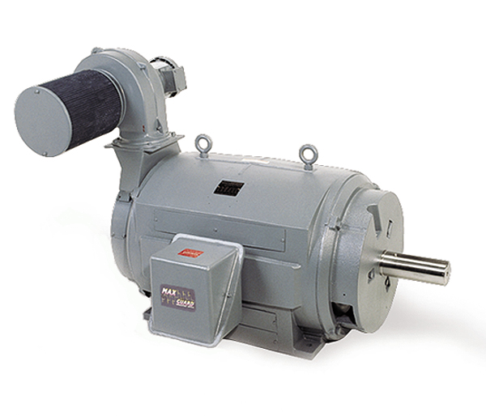
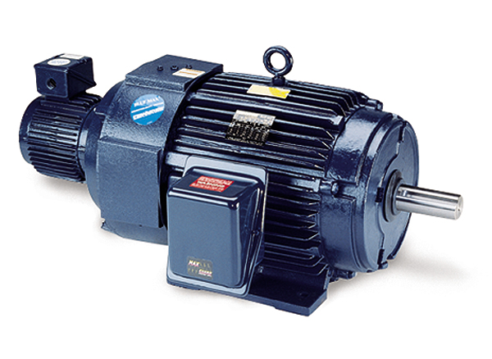
Types of Motor Enclosures
TEBC
Totally enclosed blower-cooled
Totally enclosed enclosure with external cooling means such as a separately controlled motor/blower
Notes:
The totally enclosed blower type motor is often times called an inverter duty motor. The enclosure has no ventilation openings, and is externally cooling by a separately powered motor/ blower combination. This allows the speed range of this motor to be much wider then the TEFC type motor. Typically a TEBC type motor speed range is about 10:1 and some goes a high as 1000:1. This arrangement allows continuous running at very low speeds.

Slide 34
Question?
Can VFDs turn motors faster than magnetic motor starters or reduced voltage starters?
YES
Answer:
Notes:
Inverters turn motors slower than magnetic motor starters or reduced voltage starters
Answer: Yes. The frequency range specifications of our inverters allows operation up to 400 Hz. When the motor is used above 60 Hz, the motor mechanical design should be verified.

Slide 35
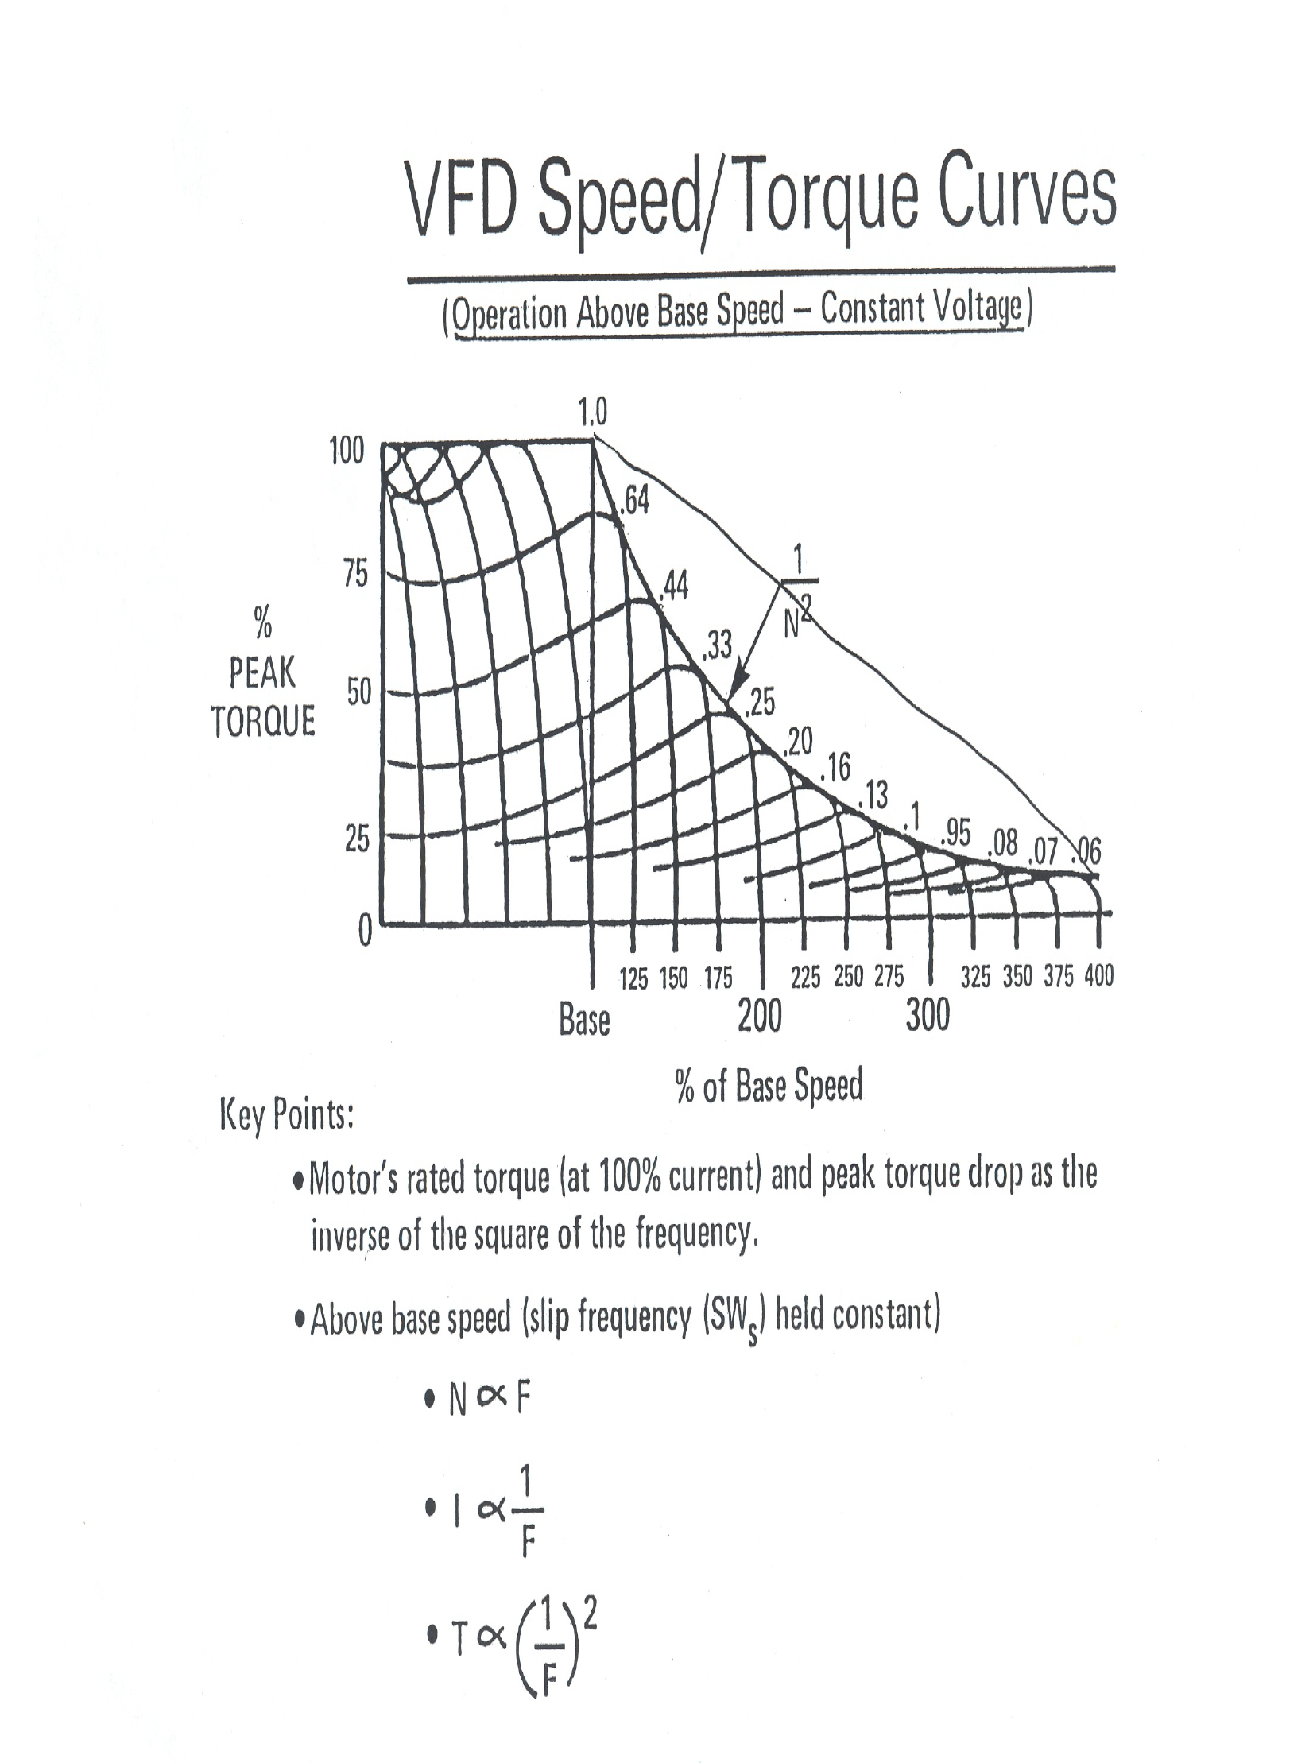

Slide 36
Carrier Frequency (f_{c})
The number of pulses per second from the VFD to the motor
f_{c} helps produce an output waveform

Slide 37
VFD Principle No. 5
More on time means higher output voltage
Ton
Ton
Ton
= 50%
= 75%
= 90%
Tc
Tc
Tc
Ton
Ton
Ton
Tc
Tc
Tc

Slide 38
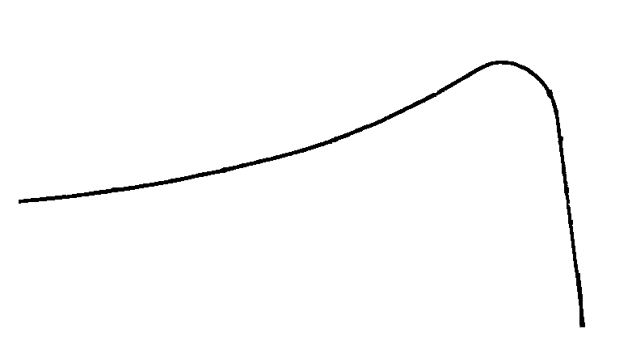
VFD Principle No. 6
Torque production when connected to an inverter
TORQUE
Locked Rotor Torque (150%)
Full Load Torque (100%)
Fout (Hz)
60
Notes:
Torque production of an induction motor when connected to an inverter is slightly different then what we have been previously discussing. The speed torque curve when running on the inverter at 60Hz will be the same as running across the line at 60Hz. But......

Slide 39
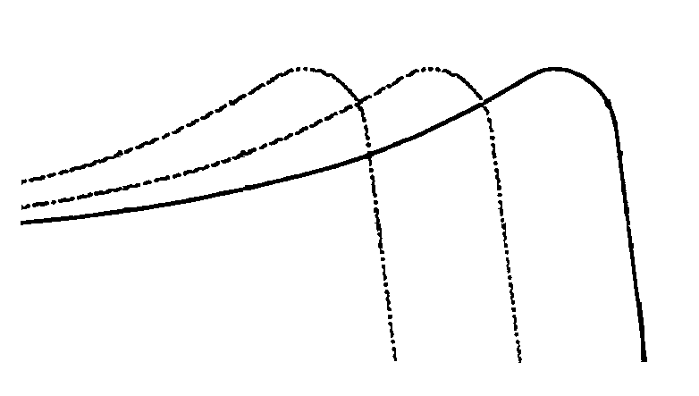
VFD Principle No. 6
Torque production when connected to an inverter
TORQUE
Locked Rotor Torque (150%)
Full Load Torque (100%)
Fout (Hz)
60
Notes:
With the inverter we have the ability to change the frequency. This change in frequency shifts the speed torque curve over. As the frequency varies, the speed torque curve varies and the motor continuously runs in the outer edge of the torque curve. This area ( if you remember to a previous slide) is the area where the torque and current lines cross.

Slide 40
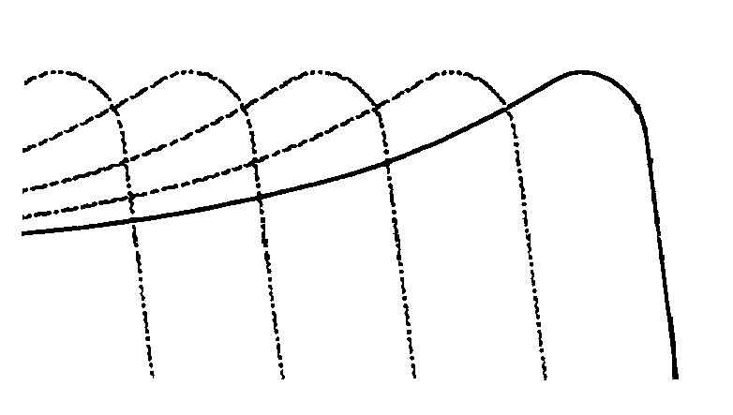
VFD Principle No. 6
Torque production when connected to an inverter
TORQUE
Locked Rotor Torque (150%)
Full Load Torque (100%)
3.0
Fout (Hz)
60
Notes:
As the frequency becomes less, we start to loose the maximum available torque.

Slide 41
Component Identification Exercise
A
B
Notes:
Identify each component.
A: Electric Motor Rotor
B: Inverter Control Board

Slide 42
Component Identification Exercise
C
D
Notes:
Identify each component.
C: Output Transistor Module
D: DC Bus Capacitor

Slide 43
Component Identification Exercise
E
F
Notes:
Identify each component.
E: DC Bus Fuse
F: Soft Charge Resistor

Slide 44
Component Identification Exercise
G
H
I
Notes:
Identify each component.
G: Input Diode Module (Rectifier)
H: Soft Charge Contactor
I: Electric Motor Stator

Slide 45
Other Important
Inverter Information

Slide 46
Topics of Discussion
Figuring MCCB Current Rating
Single Phase Input
Motor Overload Protection Package
Operating Multiple Motors
Input Contactor
Output Contactor
High Altitude Derating
Input/Output Reactors
DC Link Choke
NEMA/IEC Enclosure Ratings

Slide 47
Figuring MCCB Current Rating
Rule of Thumb: MCCB ≥ 115% of drive input current rating
I_{in} =
Where: I_{in} = Input fuse/MCCB Rating V_{inv} = Inverter rated output voltage Ii_{nv} = Inverter rated output current x 150% V_{in} = Nominal input voltage Pfs = Power system power factor Pfm = Motor power factor
V_{inv} x Pfm x I_{inv}
Vi_{n} x Pf
Notes:
The MCCB/disconnect/input fuses need to be part of a UL-listed combination controller having coordinated motor overload and short-circuit and ground fault protection in each conductor.

Slide 48
Figuring MCCB Current Rating
Calculation Example: VFD Rated Current: 12 A Nominal Input Voltage: 460Vac VFD Rated Output Voltage: 460Vac Input Power Factor: 0.72 Motor Power Factor: 0.85
460V x 12A x 0.85
4692
=
=
14.167 Amps
460V x 0.72
331.2

Slide 49
Question?
Can existing standard (non-inverter duty) motors run off a VFD?
Answer:
YES

Slide 50
Single-Phase Input
Several models of VFDs can operate off single-phase input voltage and supply three-phase voltage to the motor
Can we operate a VFD with 115Vac, single-phase input voltage and operate a 230Vac, three-phase motor?
YES
Notes:
Show 115Vac VS-Mini/GPD205 demo after last bullet point.
Generally, when operating a VFD off single-phase input voltage, you must derate the VFD.

Slide 51
Motor Overload Protection
VFDs include electronic thermal overload protection to protect the motor
Adjustable to the motor rated current
Speed & non-temperature dependent

Slide 52
Operating Multiple Motors
When more than one motor is driven in parallel with a single VFD, select the VFD capacity so that:
Operating multiple motors requires a separate overload device for each motor
VFD Output Current ≥ Total Motor FLA x 1.1
Notes:
It is a good idea to have separate overload means when operating multiple motors off one drive just in case each motor has a different FLA rating, no matter if it is an “AND” or “OR” configuration.

Slide 53
Operating Multiple Motors
VFD
O/L
O/L
O/L
M
M
M
Notes:
It is a good idea to have separate overload means when operating multiple motors off one drive just in case each motor has a different FLA rating, no matter if it is an “AND” or “OR” configuration.

Slide 54
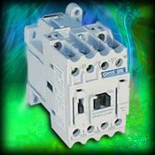
Input Contactor
A VFD can be used without an input contactor
Do not use an input contactor frequently for start/stop operation or it will lead to reduced VFD life
Notes:
An advantage of using an input contactor is it can prevent an automatic restart after recovery from an external power loss during remote control operation.
When the digital operation is used, automatic restart after power failure is disabled so that input contactor starting is impossible. Although the input contactor can stop the inverter, regenerative braking is disabled and the motor coasts to a stop. When dynamic braking resistor unit is used, build a sequence where the input contactor is turned off at the braking resistor unit thermal relay contact.

Slide 55
Output Contactor
A VFD can be used without an output contactor
Opening or closing an output contactor with the VFD running can cause damage to the VFD
Notes:
If an output contactor is used for switching to commercial power supply, switch the output contactor after the inverter and motor stop.
To switch during rotation, use the speed search function.

Slide 56
Embedded Functional Safety
Flexibility
Safe Torque Off (STO)
Safety Category 3 Solution
TUV certified to EN/ISO 13849-1 (PLd) and IEC 62061 (SIL CL2)
Status feedback signals to safety controller (relay)
Safety rated
Input devices
Power Supply
A1000
Fix mechanical problems or perform maintenance without lockout / tagout !
Save $$ with this integrated solution !
Safety controller
Controller
HC
Feedback loop
H1
H2
EDM
DM+
DM-
Motor

Slide 57
High Altitude Derating
Power conversion equipment is derated above a certain altitude, usually 3300 ft.
Equipment that depends on air for its insulation & cooling has a higher temperature rise and lower dielectric strength values
Notes:
The effect of high altitudes may eventually result in thermal damage to the power semi-conductors and related components (reduced effectiveness of heat sinks) as well as lower dielectric withstand capabilities

Slide 58
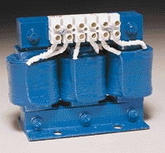
Input Reactor
Keeps VFD harmonics off utility
Keeps utility harmonics off VFD
Decreases voltage available to VFD

Slide 59
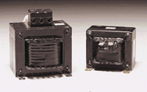
DC Reactor
Helps reduce harmonics without reducing input voltage
Does not protect Diodes from line side power issues
Notes:
Power factor with DC Reactor = 0.90
Power factor without DC Reactor = 0.65
A DC reactor is simply an inductor located ion the ripple filter circuit, placed before the DC bus capacitors. The added inductance limits the di/dt of line current into the DC bus capacitors. In many specifications, it is typical to substitute a DC link choke in place of a three-phase reactor.

Slide 60
Output Reactor
Located at output of VFD
motor cable lengths 1000’ – 3000’
when motor impedance is low compared to general purpose motors

Slide 61
Sine Wave Filter
Located at output of VFD
motor cable lengths greater than 3000’
Motors NOT rated for VFD duty

Slide 62
NEMA/UL/CSA Enclosure Types
Notes:
These are the most common NEMA, UL and CSA enclosure ratings.

Slide 63
IEC Protection Classifications
Notes:
These are the most common International Standards’ IP Protection classifications.

Slide 64
Exercise
Answer the following questions using your knowledge and/or the documents from this class.
1.) At what altitude do you start to derate power conversion equipment?
2.) Write the formula you need to calculate when operating multiple motors off one VFD
3.) One cannot apply single phase input voltage to a VFD & get three phase output voltage (True or False)
4.) Name the enclosure type that protects electronic equipment against water & corrosion

Slide 65
Exercise
Answer the following questions using your knowledge and/or the documents from this class.
1.) At what altitude do you start to derate power conversion equipment?
3,300 FEET
2.) Write the formula you need to calculate when operating multiple motors off one VFD
VFD OUTPUT CURRENT ≥ TOTAL MOTOR FLA x 1.1
3.) One cannot apply single phase input voltage to a VFD & get three phase output voltage (True or False)
TRUE
4.) Name the enclosure type that protects electronic equipment against water & corrosion
NEMA 4X

Slide 66
Questions???

